Slide 1
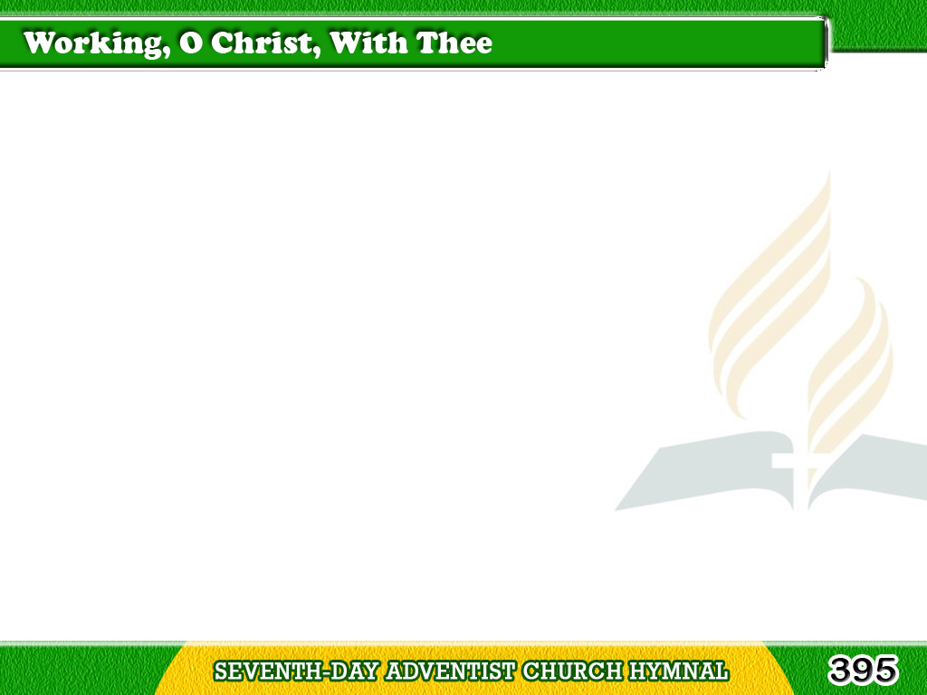
1/4
Working, O Christ, with Thee,
Working with Thee,
Unworthy, sinful, weak,
Though we may be;
Tagalog
Version

Slide 2
1/4
Our all to Thee we give,
For Thee alone we live,
And by Thy grace achieve,
Working with Thee.
Tagalog
Version

Slide 3
2/4
Along the city’s waste,
Working with Thee,
Our eager footsteps haste,
Like Thee to be;
Tagalog
Version

Slide 4
2/4
The poor we gather in,
The outcasts raise from sin,
And labor souls to win,
Working with Thee.
Tagalog
Version

Slide 5
3/4
Savior, we weary not,
Working with Thee,
As hard as Thine our lot
Can never be;
Tagalog
Version

Slide 6
3/4
Our joy and comfort this,
“Thy grace sufficient is;”
This changes toil to bliss,
Working with Thee.
Tagalog
Version

Slide 7
4/4
So let us labor on,
Working with Thee,
‘Til earth to Thee is won,
From sin set free;
Tagalog
Version

Slide 8
4/4
‘Til men, from shore to shore,
Receive Thee, and adore,
And join us evermore,
Working with Thee.
Tagalog
Version

